Slide 1

Embedding Models for Addressing Linguistic Challenges
Presented BY: Trung Kien Nguyen
INSTITUTION: A2I2 – DEAKIN UNIVERSITY
MENTORS: Scott Barnett & Sheng wong
Date: Tuesday, December 17, 2024

Slide 2
AGENDA
Background and Problem Statement
Objectives
Datasets and Methodology
Experiments and Findings
Challenges and Recommendations
Conclusion and Future Work

Slide 3
BACKGROUND & PROBLEM STATEMENT
Context: Current SOTA text embedding models excel in general tasks but struggle with nuanced linguistic challenges.
Key Problems:
Handling Nuanced Meanings
Complex Relationships
Contextual Awareness
Evaluation Metrics.
Significance: Limitations affect applications needing deeper language understanding

Slide 4
OBJECTIVES
Primary Goal: Enhance embedding models to effectively process complex linguistic phenomena.
Specific Objectives:
Evaluate Existing Models
Dataset Exploration
Introduce Better Metrics
Provide Actionable Insights

Slide 5
DATASETS USED
NevIR Dataset
Focus: Evaluates the ability of models to handle negation.
Structure:
Queries (q1, q2) and Documents (doc1, doc2).
Key Aspect: doc2 introduces negation differences from doc1.
Link: https://huggingface.co/datasets/orionweller/NevIR
Causality Dataset
Focus: Differentiates between cause and effect relationships.
Structure: Premises, questions, and multiple-choice options (Cause A, Cause B, Effect A, Effect B).
Link: https://github.com/EternityYW/TRAM-Benchmark/blob/main/datasets/causality.zip
NLI Dataset
Focus: Identifies Natural Language Inference relationships: Entailment, Neutral, and Contradiction.
Structure: Premise-Hypothesis pairs categorized into logical relationships.
Link: https://github.com/EternityYW/TRAM-Benchmark/blob/main/datasets/nli_mcq.zip
Purpose of Datasets:
Provide diverse benchmarks for testing linguistic understanding.
Address specific challenges in negation, causality, spatial reasoning, and logical inference.

Slide 6
METHODOLOGY
Dataset Preparation
Embedding models
Selected NV-Embed-v2 for generating embeddings (HuggingFace repository).
Embedded text pairs (queries, documents, premises, and hypotheses).
Evaluation Metrics
Cosine Similarity
Density Distribution Analysis
Experimentation
Negation Detection
Causal reasoning
Logical inference (NLI)

Slide 7
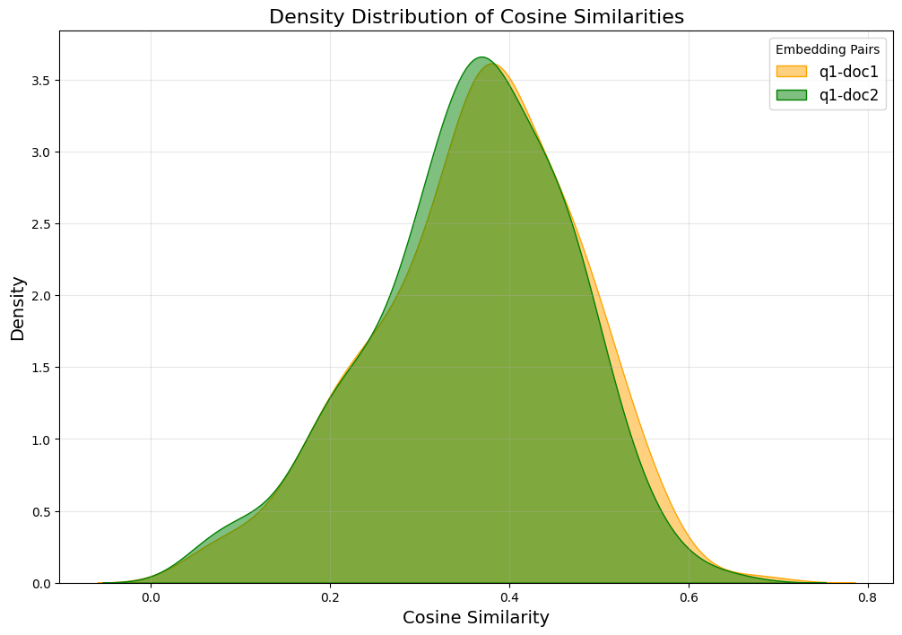
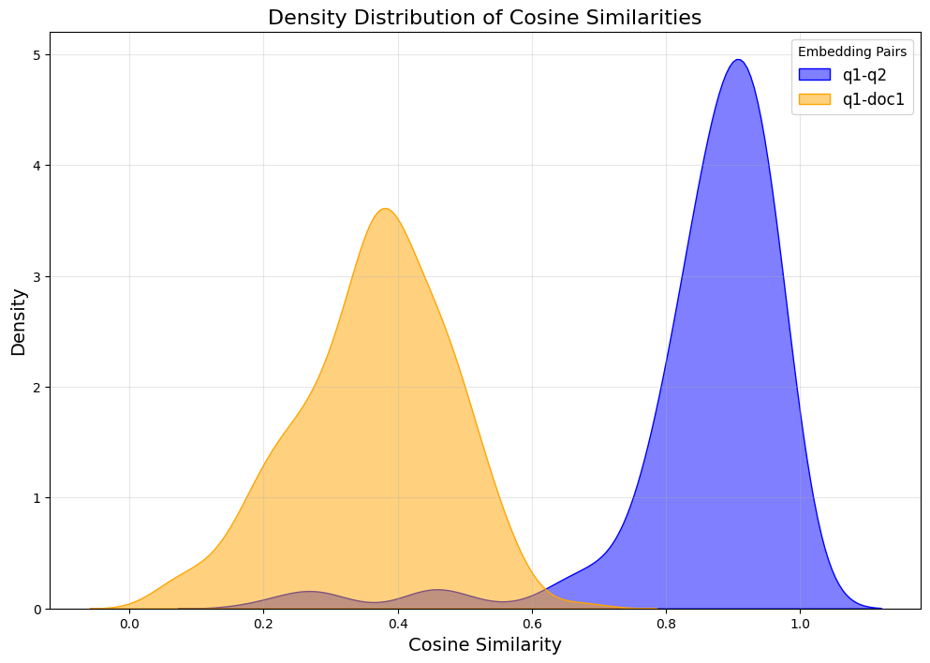
EXPERIMENTS CONDUCTED
Negation Handling (NevIR Dataset)
Compared similarity between queries and negated documents.
Observation:
Failed to capture the difference between Q1 & Q2
Failed to capture the similarity between Q1 & Doc1
Overlapping means it failed to capture the difference between the two documents (doc1 and doc2), which is expected to be significant

Slide 8
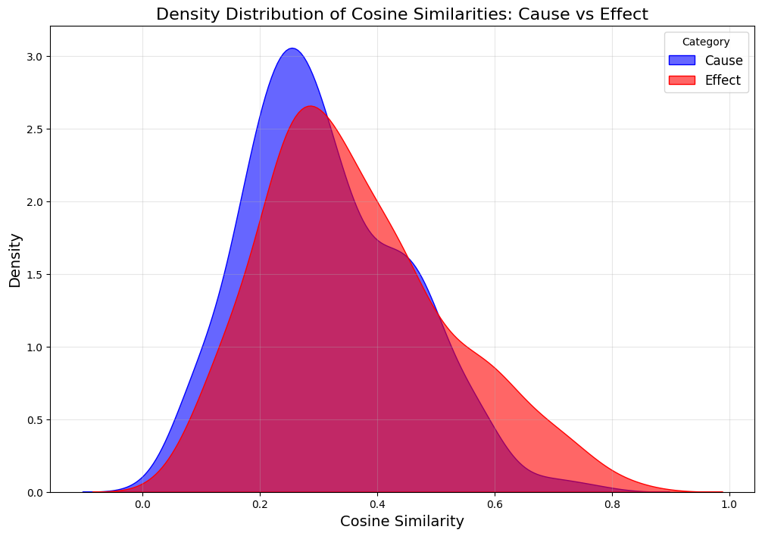
EXPERIMENTS CONDUCTED
Causal Reasoning (Causality Dataset)
Evaluated semantic similarity between causes and effects.
Observation:
Failed to capture the similairity between two causes, or two effects (0.35 to 0.4 at peak)
Overlap in scores highlighted difficulty in differentiation.

Slide 9
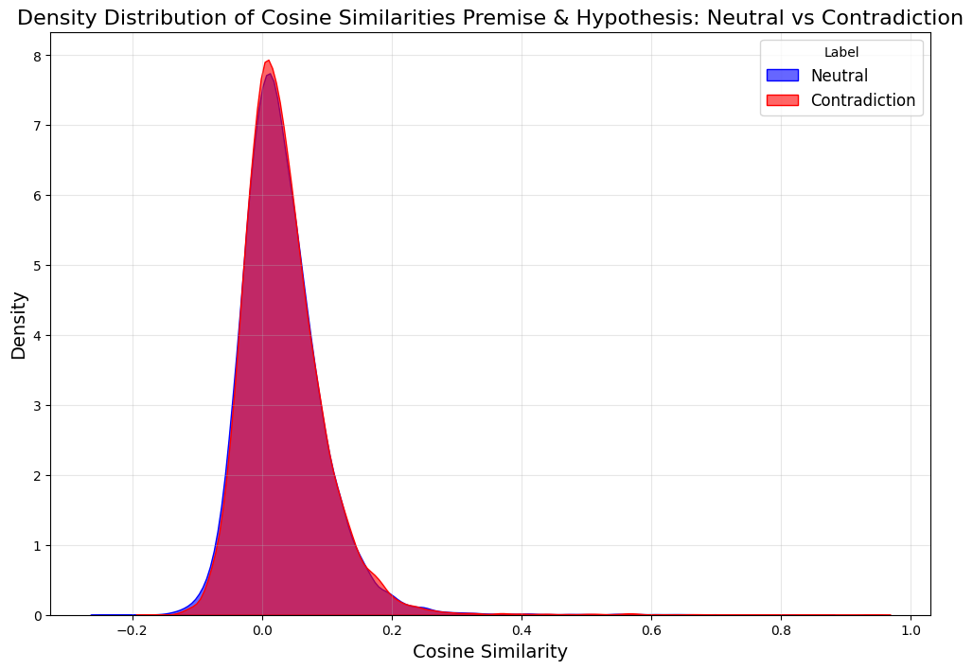
EXPERIMENTS CONDUCTED
Logical Inference (NLI Dataset)
Compared neutrality, and contradiction pairs.
Observation:
Overlap means it failed to distinguish the NLI relationship (Neutral or Contradiction)

Slide 10
CONCLUSION AND REFLECTION
Current SOTA Embeding models struggle with nuanced semantic tasks like negation, causality, and logical inference.
Negation is Poorly Handled
Cause and Effect Relationships Lack Distinction
Significant overlap in Logical Relationships
Cosine Similarity Alone is Inadequate
Advancing embedding models for linguistic challenges will pave the way for better real-world applications in NLP.

Slide 11
RECOMMENDATIONS AND FUTURE WORK
Task-Specific Models Development
Enhanced Metrics
Dataset Expansion
Fine-Tuning Pipelines

Slide 12
THANK YOU FOR LISTENING

